Slide 1
CPI Inflation India: Case Study
Author: Vishwanshu Kumar Mishra

Slide 2
Introduction
Consumer Price Index: The Consumer Price Index (CPI) is a measure of the average change over time in the prices of a "basket" of goods and services, like food, housing, and transportation, that are typically purchased consumers.
Broad Categories for CPI Inflation Inida (Rural+Urban, Rural & Urban Sectors , Period: Jan, 2013 to May, 2023) :
Food Products: Cereals and products, Meat and fish, Egg, Milk and products, Oils and fats, Fruits, Vegetables, Pulses and products, Sugar and Confectionery, Spices, Non-alcoholic beverages, Prepared meals, snacks, sweets etc. & Food and beverages.
Clothing & Misc: Clothing, Footwear & Clothing and footwear
Housing & Misc: Housing, Fuel and light & Household goods and services
Health and personal Care: Health & Personal care and effects
Transport and communication
Education and Entertainment: Recreation and amusement & Education
Miscellaneuos: Pan, tobacco and intoxicants & Miscellaneous

Slide 3
Insights
Contribution to CPI (Latest Month)- May, 2023
YoY(Year-on-Year) CPI Inflation - 2017 Onwards
Month-on-Month CPI: Food Products (June,22-May,23)
CPI Inflation : Pre- Covid Vs Post- Covid
CPI Inflation : Crude Oil CPI Influence
Conclusion

Slide 4
Contribution to CPI (Latest Month)
Rural+Urban Sector ( May, 2023)
Category | CPI_Value | Contribution_%
Food Products | 2306.9 | 49.6%
Clothing & Misc | 553.2 | 11.9%
Housing & Misc | 533.6 | 11.5%
Health and personal Care | 370.9 | 8.0%
Transport and communication | 164.8 | 3.5%
Education and Entertainment | 348.3 | 7.5%
Miscellaneuos | 376.7 | 8.1%
Total | 4654.4 | 100.0%
Highest Contributor : Food Products
Minimum Contribution: Transport & Communication

Slide 5
Contribution to CPI (Latest Month)
Rural Sector ( May, 2023)
Category | CPI_Value | Contribution_%
Food Products | 2290.7 | 49.4%
Clothing & Misc | 569.9 | 12.3%
Housing & Misc | 501.55 | 10.8%
Health and personal Care | 372.7 | 8.0%
Transport and communication | 169.7 | 3.7%
Education and Entertainment | 354.1 | 7.6%
Miscellaneuos | 379.4 | 8.2%
Total | 4638.05 | 100.0%
Highest Contributor : Food Products
Minimum Contribution: Transport & Communication

Slide 6
Contribution to CPI (Latest Month)
Urban Sector ( May, 2023)
Category | CPI_Value | Contribution_%
Food Products | 2335.1 | 50.3%
Clothing & Misc | 528.7 | 11.4%
Housing & Misc | 529.1 | 11.4%
Health and personal Care | 367.8 | 7.9%
Transport and communication | 160.4 | 3.5%
Education and Entertainment | 344 | 7.4%
Miscellaneuos | 375.8 | 8.1%
Total | 4640.9 | 100.0%
Highest Contributor : Food Products
Minimum Contribution: Transport & Communication

Slide 7
YoY CPI Inflation - 2017 Onwards
Rural+Urban Sector ( 2017 Onwards)
Year | Average General Index | YoY Inflation (%)
2017 | 133.50
2018 | 138.78 | 3.95
2019 | 144.18 | 3.90
2020 | 153.38 | 6.38
2021 | 161.46 | 5.27
2022 | 172.15 | 6.62
2023 | 177.62 | 3.18
Findings:
The year with the highest inflation is 2022, with a YoY CPI inflation rate of approximately 6.62%.
The CPI “General Index” for 2022 was 172.15, marking the steepest increase since 2017.
Graph Insights:
Inflation remained moderate (~4%) from 2017–2019
It spiked sharply in 2020, likely due to COVID-19 supply chain disruptions and food price shocks.
After a brief dip in 2021, it peaked again in 2022, surpassing 6.6%.
In 2023, inflation eased, reflecting normalization in supply chains and stable commodity prices.

Slide 8
YoY CPI Inflation - 2017 Onwards
Rural Sector ( 2017 Onwards)
Year | Average General Index | YoY Inflation (%)
2017 | 135.63
2018 | 140.73 | 3.76
2019 | 145.18 | 3.16
2020 | 154.56 | 6.46
2021 | 162.03 | 4.84
2022 | 173.13 | 6.85
2023 | 178.48 | 3.09
Findings:
The year with the highest inflation is 2022, with a YoY CPI inflation rate of approximately 6.85%.
The CPI “General Index” for 2022 was 173.13, marking the steepest increase since 2017.
Graph Insights:
Inflation remained moderate (~5%) from 2017–2019
It spiked sharply in 2020, likely due to COVID-19 supply chain disruptions and food price shocks.
After a brief dip in 2021, it peaked again in 2022, surpassing 6.85%.
In 2023, inflation eased, reflecting normalization in supply chains and stable commodity prices.

Slide 9
YoY CPI Inflation - 2017 Onwards
Urban Sector ( 2017 Onwards)
Year | Average General Index | YoY Inflation (%)
2017 | 131.03
2018 | 136.50 | 4.18
2019 | 143.02 | 4.78
2020 | 152.05 | 6.32
2021 | 160.76 | 5.73
2022 | 170.95 | 6.34
2023 | 176.62 | 3.32
Findings:
The year with the highest inflation is 2022, with a YoY CPI inflation rate of approximately 6.34%.
The CPI “General Index” for 2022 was 170.95, marking the steepest increase since 2017.
Graph Insights:
Inflation remained moderate (~5%) from 2017–2019
It spiked sharply in 2020, likely due to COVID-19 supply chain disruptions and food price shocks.
After a brief dip in 2021, it peaked again in 2022, surpassing 6.34%.
In 2023, inflation eased, reflecting normalization in supply chains and stable commodity prices.

Slide 10
YoY CPI Inflation - 2017 Onwards
Possible Reasons (Research-Based):
2022 Inflation Surge Drivers:
Global supply chain crisis post-pandemic.
Russia-Ukraine war led to spikes in crude oil, fertilizer, and food grain prices.
Imported inflation due to rising commodity costs.
Rupee depreciation increased import costs.
High food inflation (especially cereals, vegetables, and oils).
#NOTE: Why April & May 2020 CPI Data Are Missing:
During April and May 2020, India was under nationwide COVID-19 lockdown.
As a result: National Statistical Office (NSO) could not collect retail price data due to mobility restrictions. Therefore, official CPI data were not released for those months. This is confirmed in NSO’s official notice and the RBI’s inflation reports for 2020

Slide 11
Month-on-Month CPI: Food Products (June,22-May,23)
Rural+Urban
Food subcategory | Start (Jun 2022) | End (May 2023) | Absolute Change | Percentage Change (%)
Spices | 187.1 | 218 | 30.9 | 16.52%
Cereals and products | 155 | 173.7 | 18.7 | 12.06%
Milk and products | 165.8 | 179.5 | 13.7 | 8.26%
Pulses and products | 164.3 | 175.6 | 11.3 | 6.88%
Prepared meals, snacks, sweets etc. | 183.9 | 194.2 | 10.3 | 5.60%
Non-alcoholic beverages | 167.9 | 173.4 | 5.5 | 3.28%
Food and beverages | 174.9 | 179.1 | 4.2 | 2.40%
Sugar and Confectionery | 119.9 | 122.7 | 2.8 | 2.34%
Fruits | 169.7 | 172.2 | 2.5 | 1.47%
Egg | 170.8 | 173.2 | 2.4 | 1.41%
Meat and fish | 219.4 | 214.3 | -5.1 | -2.32%
Vegetables | 182.3 | 161 | -21.3 | -11.68%
Oils and fats | 200.9 | 170 | -30.9 | -15.38%
Total | 173.99 | 177.45 | 3.46 | 1.99%
Over Jun-2022 → May-2023 the Food Index rose ≈ 1.99% (unweighted). That’s a modest net rise over the 12 months.
Spices had the largest absolute increase among food subcategories (≈ +30.9 index points, +16.5%), so within the food bucket spices contributed most to the Food Index rise in this 12-month window (by absolute index change).

Slide 12
Month-on-Month CPI: Food Products (June,22-May,23)
Rural+Urban
The largest monthly uptick in the window occurred in May 2023 (+0.76% MoM), while February 2023 saw the steepest drop (−0.59% MoM).
#Biggest Indivdual Category Contributor : Spices

Slide 13
Month-on-Month CPI: Food Products (June,22-May,23)
Rural
Food subcategory | Start (Jun 2022) | End (May 2023) | Absolute Change | Percentage Change (%)
Spices | 188.9 | 221 | 32.1 | 16.99%
Cereals and products | 153.8 | 173.2 | 19.4 | 12.61%
Milk and products | 165.4 | 179.6 | 14.2 | 8.59%
Pulses and products | 164.6 | 174.9 | 10.3 | 6.26%
Prepared meals, snacks, sweets etc. | 181.9 | 191.1 | 9.2 | 5.06%
Non-alcoholic beverages | 174.2 | 178.7 | 4.5 | 2.58%
Food and beverages | 172.4 | 176.8 | 4.4 | 2.55%
Sugar and Confectionery | 119.1 | 121.9 | 2.8 | 2.35%
Fruits | 165.8 | 169 | 3.2 | 1.93%
Egg | 169.6 | 171 | 1.4 | 0.83%
Meat and fish | 217.2 | 211.5 | -5.7 | -2.62%
Vegetables | 167.3 | 148.7 | -18.6 | -11.12%
Oils and fats | 208.1 | 173.3 | -34.8 | -16.72%
Toatl | 172.95 | 176.21 | 3.26 | 1.89%
Over Jun-2022 → May-2023 the Food Index rose ≈ 1.89% (unweighted). That’s a modest net rise over the 12 months.
Spices had the largest absolute increase among food subcategories (≈ +32.1 index points, +16.99%), so within the food bucket spices contributed most to the Food Index rise in this 12-month window (by absolute index change).

Slide 14
Month-on-Month CPI: Food Products (June,22-May,23)
Rural
The largest monthly uptick in the window occurred in May 2023 (+0.726% MoM), while January 2023 saw the steepest drop (−0.766% MoM).
#Biggest Indivdual Category Contributor : Spices

Slide 15
Month-on-Month CPI: Food Products (June,22-May,23)
Urban
Food subcategory | Start (Jun 2022) | End (May 2023) | Absolute Change | Percentage Change (%)
Spices | 183.5 | 211.9 | 28.4 | 13.40
Cereals and products | 157.5 | 174.7 | 17.2 | 9.85
Pulses and products | 163.6 | 176.9 | 13.3 | 7.52
Milk and products | 166.4 | 179.4 | 13 | 7.25
Prepared meals, snacks, sweets etc. | 186.3 | 197.7 | 11.4 | 5.77
Non-alcoholic beverages | 159.1 | 165.9 | 6.8 | 4.10
Sugar and Confectionery | 121.4 | 124.2 | 2.8 | 2.25
Egg | 172.8 | 176.7 | 3.9 | 2.21
Food and beverages | 179.3 | 183.1 | 3.8 | 2.08
Fruits | 174.1 | 175.8 | 1.7 | 0.97
Meat and fish | 223.4 | 219.4 | -4 | -1.82
Vegetables | 211.5 | 185 | -26.5 | -14.32
Oils and fats | 188.6 | 164.4 | -24.2 | -14.72
Total | 175.96 | 179.62 | 3.66 | 2.08%
Over Jun-2022 → May-2023 the Food Index rose ≈ 2.08% (unweighted). That’s a modest net rise over the 12 months.
Spices had the largest absolute increase among food subcategories (≈ +28.4 index points, +13.4%), so within the food bucket spices contributed most to the Food Index rise in this 12-month window (by absolute index change).

Slide 16
Month-on-Month CPI: Food Products (June,22-May,23)
Urban
The largest monthly uptick in the window occurred in May 2023 (+0.751% MoM), while December 2022 saw the steepest drop (−0.804% MoM).
#Biggest Indivdual Category Contributor : Spices

Slide 17
CPI Inflation : Pre- Covid Vs Post- Covid
Rural + Urban
Category | Pre YoY mean (%) | Post YoY mean (%) | Δ YoY (Post−Pre) (pp) | Pre MoM mean (%) | Post MoM mean (%) | Δ MoM (pp)
Food Index (unweighted avg of food items) | 5.70 | 8.71 | 3.01 | 0.88 | 0.54 | -0.35
Health | 7.21 | 4.88 | -2.33 | 0.37 | 0.36 | -0.02
Transport and communication | 2.52 | 9.96 | 7.44 | 0.46 | 0.89 | 0.43
Household goods & services | 4.35 | 2.40 | -1.95 | 0.28 | 0.36 | 0.08
Period definitions used
Pre-Covid : 2019-03-01 → 2020-02-01
Post-Covid: 2020-04-01 → 2021-03-01
(we excluded Mar-2020 as the event month)
Rural
Category | Pre YoY mean (%) | Post YoY mean (%) | Δ YoY (Post−Pre) (pp) | Pre MoM mean (%) | Post MoM mean (%) | Δ MoM (pp)
Food Index (unweighted avg of food items) | 4.16 | 8.35 | 4.19 | 0.87 | 0.52 | -0.35
Health | 8.25 | 4.11 | -4.14 | 0.38 | 0.24 | -0.13
Transport and communication | 3.39 | 9.58 | 6.19 | 0.47 | 0.76 | 0.29
Household goods & services | 2.09 | -0.01 | -2.10 | 0.05 | 0.11 | 0.06

Slide 18
CPI Inflation : Pre- Covid Vs Post- Covid
Urban
Category | Pre YoY mean (%) | Post YoY mean (%) | Δ YoY (Post−Pre) (pp) | Pre MoM mean (%) | Post MoM mean (%) | Δ MoM (pp)
Food Index (unweighted avg of food items) | 8.50 | 9.32 | 0.83 | 0.92 | 0.57 | -0.35
Health | 5.52 | 6.22 | 0.70 | 0.38 | 0.57 | 0.19
Transport and communication | 1.52 | 10.29 | 8.77 | 0.45 | 1.03 | 0.58
Household goods & services | 4.19 | 3.36 | -0.84 | 0.32 | 0.40 | 0.09
Overall Insights:
Food inflation (YoY) rose after the lockdown onset.
Interpretation: supply disruptions (harvesting/transport/markets), logistics problems during lockdown, localized shortages and seasonal effects pushed year-on-year food price increases higher in the 12 months after the first lockdown. (This matches the general observation that food prices were an important driver of higher inflation in 2020/21.)

Slide 19
CPI Inflation : Pre- Covid Vs Post- Covid
2. Health inflation (YoY) fell after onset.
Possible reasons: temporary suspension of elective services, reduced outpatient activity early in lockdown, lower price pressures for certain services, or data collection/coverage effects for health items during lockdown. (This is plausible but would need a qualitative check against health sector reports for the period.)
3. Transport & communication inflation jumped sharply (largest increase).
Reasoning: transport was hit hard by initial lockdown (large base effect) and later saw rebounds and oil/energy price volatility. The strong increase can reflect recovery and pass-through of fuel prices as services resumed.
4. Household goods & services saw a moderate decline in YoY but small positive change in MoM — indicating short-term monthly upticks but a lower annual average
5. MoM behavior: average MoM before/after shows smaller magnitudes; for example Food MoM average decreased slightly ) meaning month-to-month food price changes were on average a bit smaller post-lockdown, but year-on-year comparisons show larger increases due to base effects and cumulative rises.

Slide 20
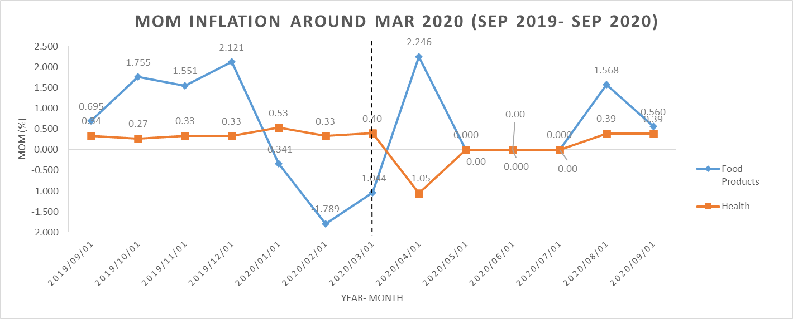
CPI Inflation : Pre- Covid Vs Post- Covid
Rural+Urban

Slide 21
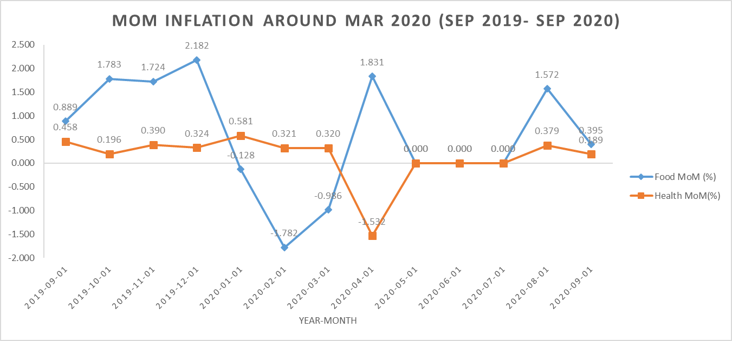
CPI Inflation : Pre- Covid Vs Post- Covid
Rural

Slide 22
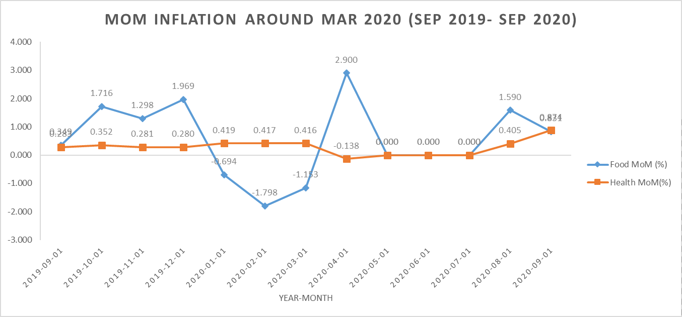
CPI Inflation : Pre- Covid Vs Post- Covid
Urban

Slide 23
CPI Inflation : Crude Oil CPI Influence
Rural + Urban (Period: Jan, 2021- May,2023)

Slide 24
CPI Inflation : Crude Oil CPI Influence
Rural (Period: Jan, 2021- May,2023)

Slide 25
CPI Inflation : Crude Oil CPI Influence
Urban (Period: Jan, 2021- May,2023)

Slide 26
CPI Inflation : Crude Oil CPI Influence
Overall Insights
1. Meat and fish (top correlated) — a positive relationship suggests that when imported crude oil rises month-to-month, meat & fish indices also tend to rise the same month. Possible channels:
Higher fuel costs → higher transport, refrigeration and feed costs → higher producer/retailer prices for meat & fish;
Second-round effects in feed/energy-intensive processing.
2. Oils and fats (2nd) — Edible oil markets are influenced by global commodity dynamics. Crude increases may coincide with broader global commodity price moves (or with shipping/transport costs) causing edible oils to rise.
3. Fuel & Transport usually are the direct pass-through channels, but here their month-to-month CPI correlation with crude is lower — possible reasons:
Domestic fuel prices are regulated/subsidized
The domestic Fuel and light index may move with a lag or influenced by local taxes and retail-price-setting.

Slide 27
Conclusion
To summarize —
Food inflation has been the main contributor to overall CPI inflation in India.
2020 and 2022 were key inflection points influenced by the pandemic and global price shocks.
By 2023, inflation began to stabilize, reflecting improved supply and demand balance
In conclusion, this study shows how interconnected food, fuel, and global factors are in shaping India’s inflation. Monitoring category-wise CPI helps policymakers and businesses anticipate inflationary pressures and plan accordingly.

Slide 28
Thank You

